Slide 1
Learner’s Presentation

Slide 2
Brazil Housing
Guidance by
- Shruthi Gode
Presented by
- Deepika Tyagi

Slide 3
Business Objectives
Work From Home (WFH) has become the new normal for workers around the world. Some companies allowing employees to work from home permanently.
Rio De Janeiro and Sao Paulo are among the most expensive cities to live in Brazil.
Analyse the housing data to identify cities in Brazil that offer affordable and spacious accommodation for bachelors, mid-sized families, and large families, taking into account the number of rooms, area, and other amenities.
Suggest cities that provide a comfortable living environment for families of different sizes, considering factors.
Providing data-driven insights to support decision-making for individuals and families planning to embrace remote work and relocate to a new city in Brazil.

Slide 4
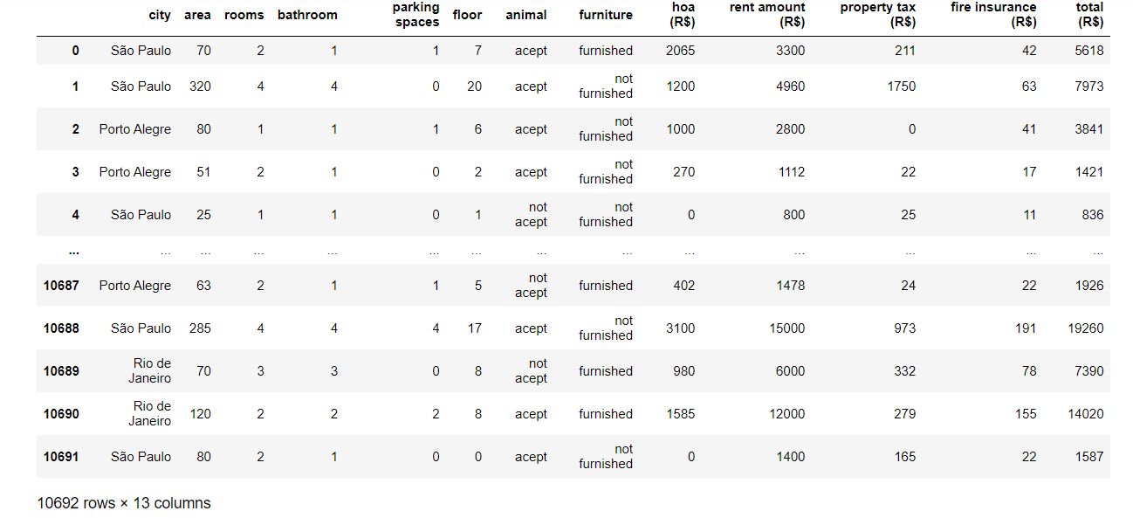
Reading the Data Frame

Slide 5
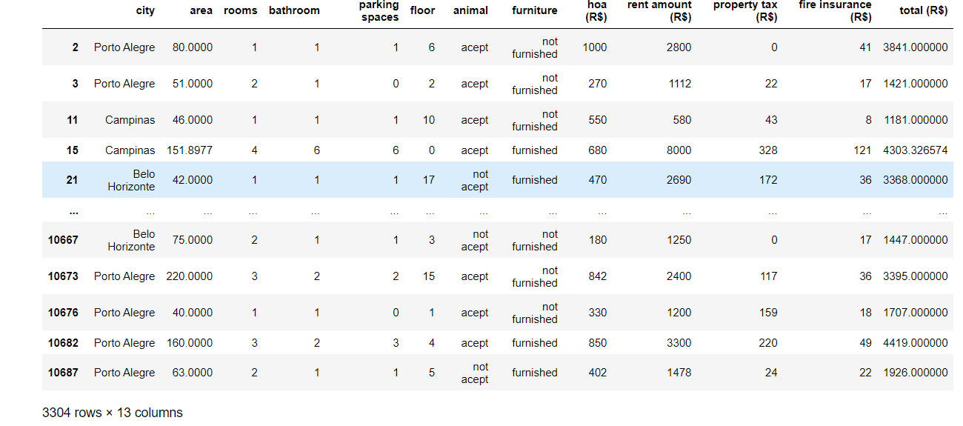
Dropping the cities ‘Rio de Janeiro’ and ‘São Paulo’ which is expensive and people want to migrate.

Slide 6
Data Cleaning and Preprocessing

Slide 7
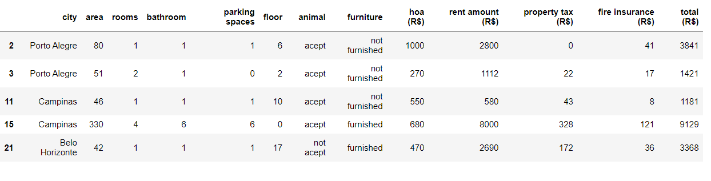
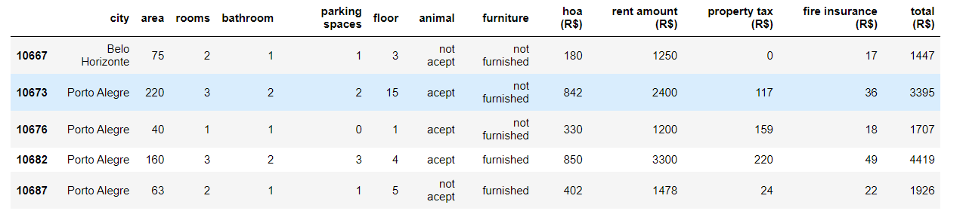
Understanding Data : Level 0
Reading the top 5 rows
Reading the bottom 5 rows

Slide 8

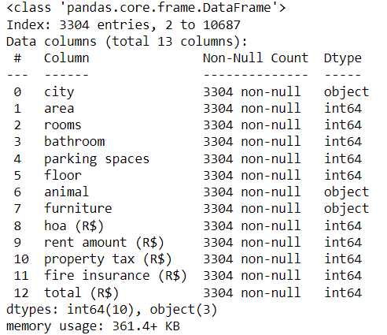
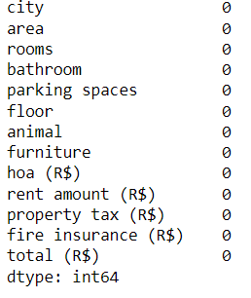
Checking for the columns
Shape of the Data
info of the Data
Checking for missing values

Slide 9
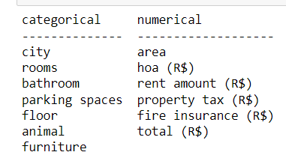
Level 1 Analysis of the Brazil Housing
It involves separating the categorical and numerical variables in the Brazil Housing dataset.
𝑈𝑛𝑖𝑣𝑎𝑟𝑖𝑎𝑡𝑒 𝐴𝑛𝑎𝑙𝑦𝑠𝑖𝑠 𝑜𝑓 𝐶𝑎𝑡𝑒𝑔𝑜𝑟𝑖𝑐𝑎𝑙 𝑉𝑎𝑟𝑖𝑎𝑏𝑙𝑒𝑠
Some of the people choose to live Campinas city 38% of the total population.
Majority of the people are accepting the animal which is 78%.
The above dataset indicates that 76% of the houses are furnished .
Generally people opt for 3 rooms followed by 2 rooms.
Majority of the people prefer for one bathroom followed by 2 ,3 and so on.
Some people are preferring 1 parking spaces only.
Usually people prefer ground floor house which adds upto 22%.

Slide 10
𝑈𝑛𝑖𝑣𝑎𝑟𝑖𝑎𝑡𝑒 𝐴𝑛𝑎𝑙𝑦𝑠𝑖𝑠 𝑜𝑓 𝑁𝑢𝑚𝑒𝑟𝑖𝑐𝑎𝑙 𝑉𝑎𝑟𝑖𝑎𝑏𝑙𝑒𝑠
Check if the data is discrete or continuous.
Measure the central tendency (mean, median, mode)
Measure the dispersion values
Check for missing values
Checking for skewness
Check for outliers
Think about how the missing values could be treated.
Think about the kind of graph/chart that can be plotted using this data.
Many people are preferring the area between 50 to 150.
Majority of the rent amount are falls in the range between 1000 to 3000.
Total amount is between 250 to 1300.

Slide 11
The dataset has 13 columns, including categorical variables such as city, animal, furniture , rooms, bathroom, parking spaces, floor and numerical variables such as area, hoa (R$), rent amount (R$), property tax (R$), fire insurance (R$), and total (R$) .
The dataset has no missing values, making it suitable for further analysis.
The dataset includes entries from various cities such as Campinas, Belo Horizonte, Porto Allegra providing a multi-city perspective on housing characteristics and costs.
The dataset details various property characteristics, including the number of rooms, bathrooms, parking spaces, and whether the properties are furnished or unfurnished, offering a comprehensive view of the housing options available in different cities.

Slide 12
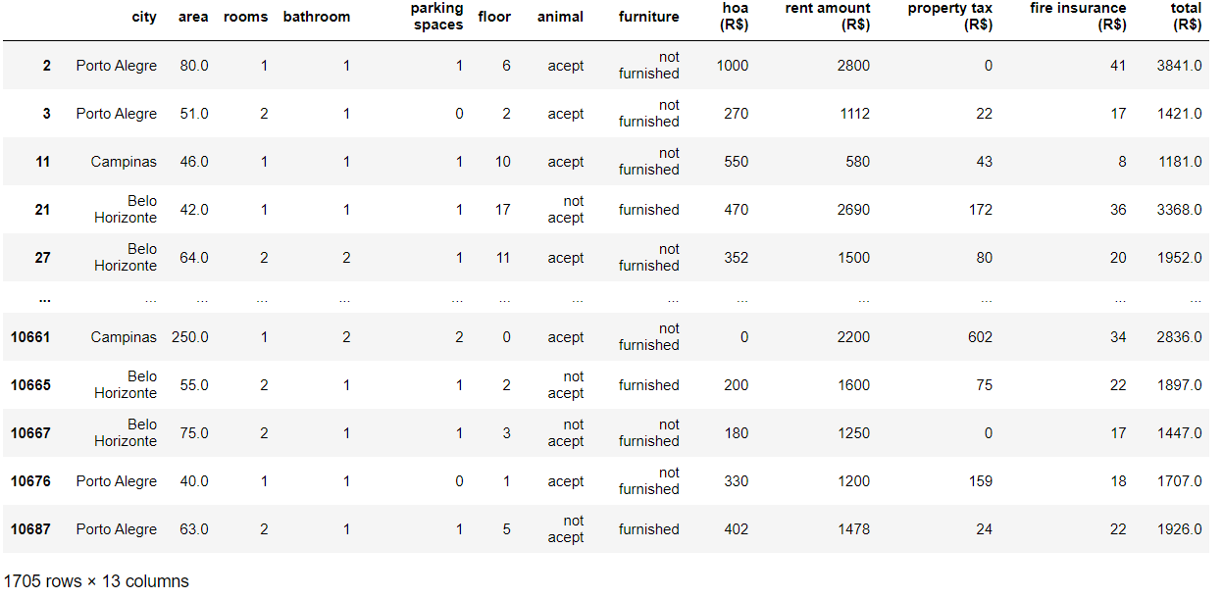
TASK-1 ANALYSIS OF ROOMS TO RELOCATE FOR BACHELORS|
LEVEL-1 UNIVARIATE ANALYSIS
filtering the data for Bachelors to relocate based on the findings of the previously mentioned univariate analysis.
Considering the number of rooms for Bachelor is less than or equal to 2.

Slide 13
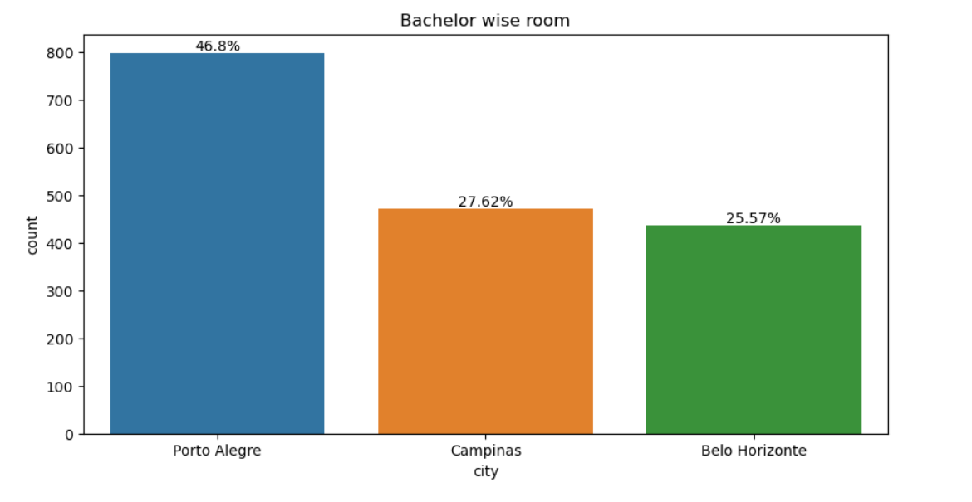
Interpretation : Based on our analysis, Porte Allegra city offers bachelors more economical, adequate living and remote work options.

Slide 14
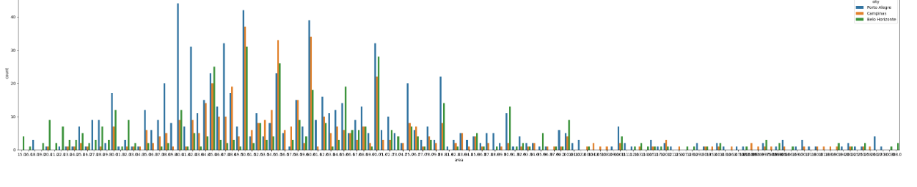
RELATIONSHIP OF CITY WITH AREA
Interpretation:As the above Countplot indicates that Port Alegre has the widest range of rooms available in the area than other two cities.Now for further analysis we will proceed to Multivaraiate analysis.

Slide 15
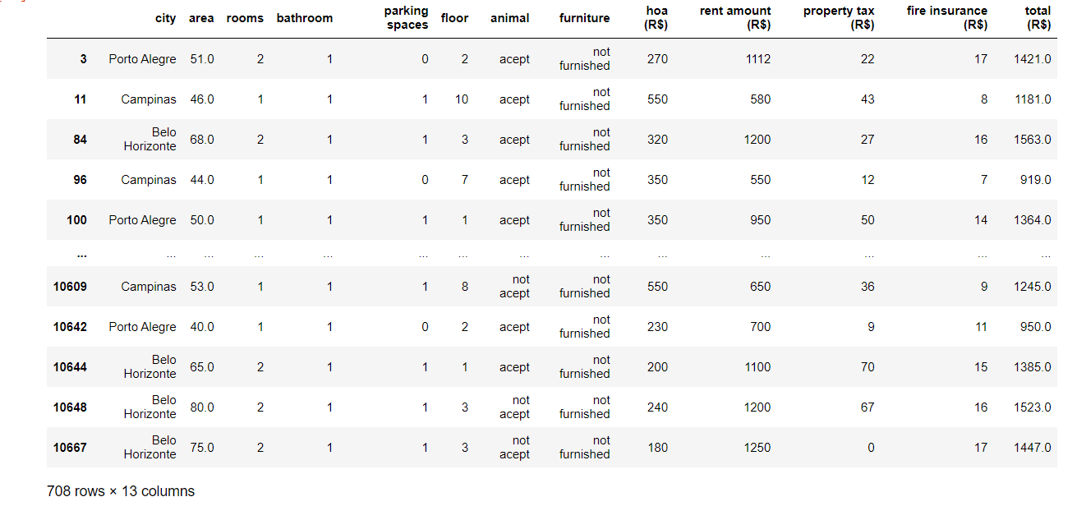
Deeper Analysis
Which city has the offer for Bachelors at most affordable price,so that they can relocate themselves.
Filtering and retrieving the data

Slide 16
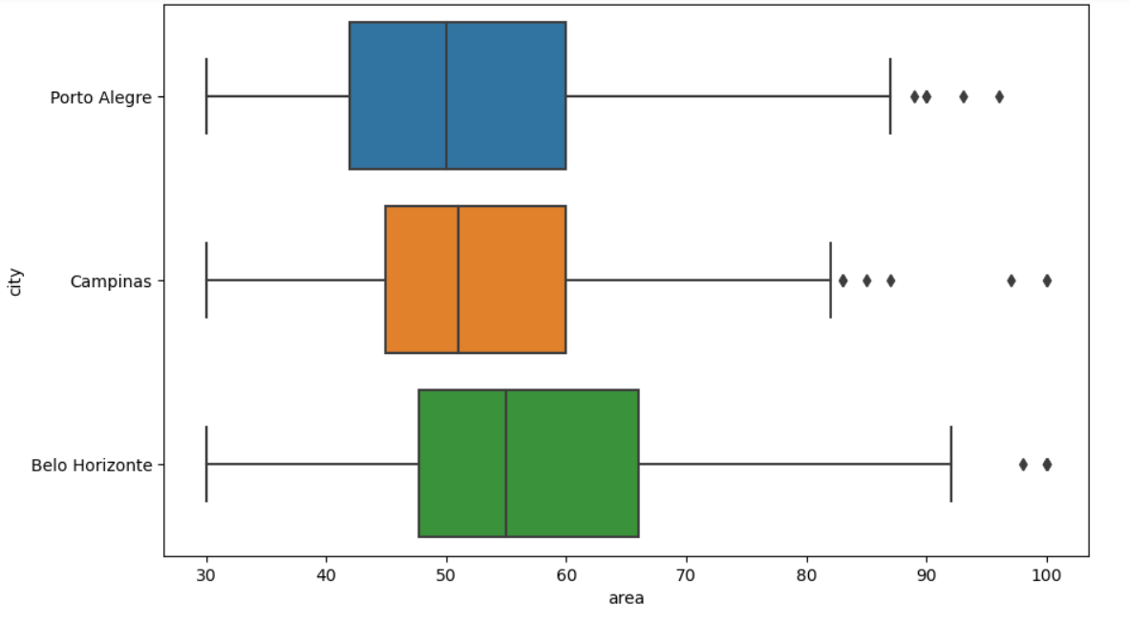
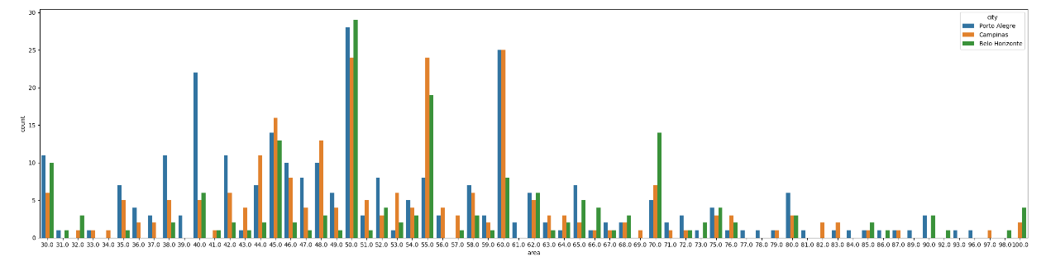

Slide 17
Interpretation:In above countplot Belo Horizonte and Port Alegre are highly recommended here for the houses of area between 30 to 100,with less than equal to 2 rooms at lowest price.So we can conclude that Belo Horizonte is the best suited city for Bachelors to relocate.

Slide 18
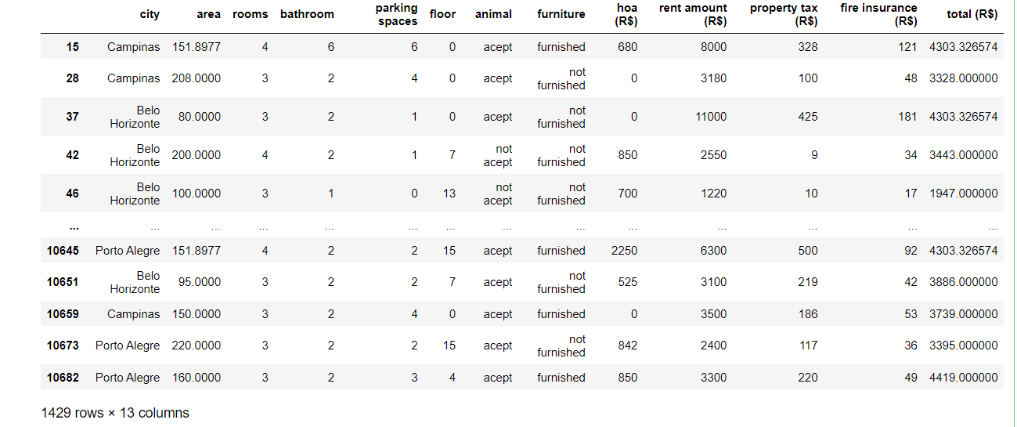
TASK-1 ANALYSIS OF ROOMS TO RELOCATE FOR BACHELORS|
LEVEL-1 UNIVARIATE ANALYSIS
filtering the data for Mid size family to relocate based on the findings of the previously mentioned univariate analysis.
Considering the number of rooms for Mid size family is more than or equal to 3.

Slide 19
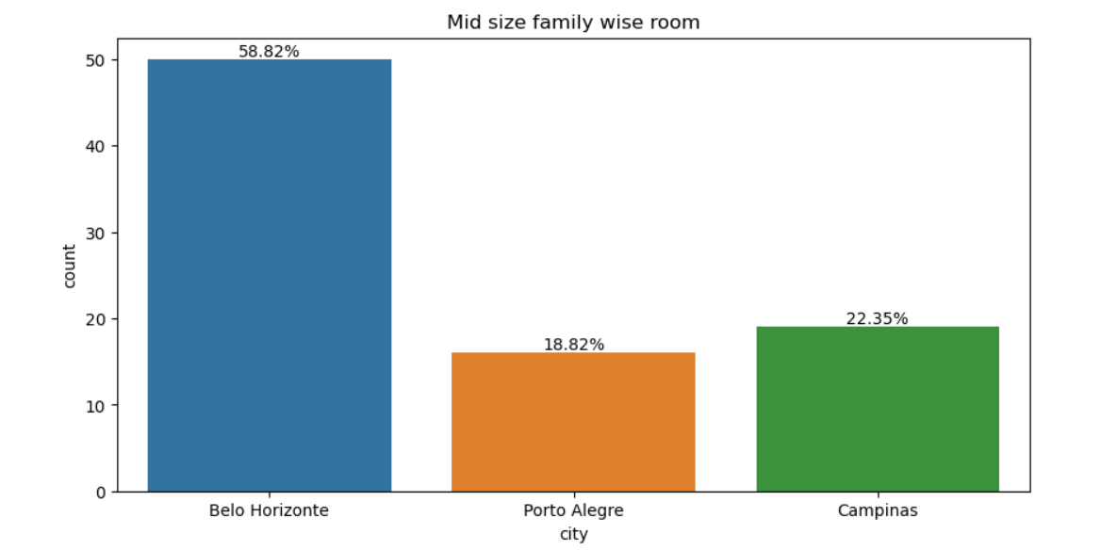
Interpretation: As the above Count plot indicates that Belo Horizonte has the highest availability of rooms that is approx. 50% for mid size family, those who wants at least 2 rooms and at most 4 rooms.

Slide 20
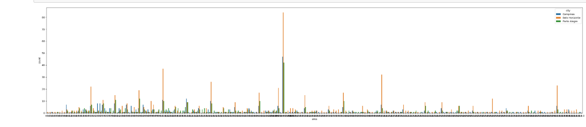
LEVEL-2 BIVARIATE ANALYSIS
RELATIONSHIP OF CITY WITH AREA
Interpretation:As the above Countplot indicates that Belo Horizonte has the widest range of rooms available in the area than other two cities.Now for further analysis we will proceed to Multivaraiate analysis.

Slide 21
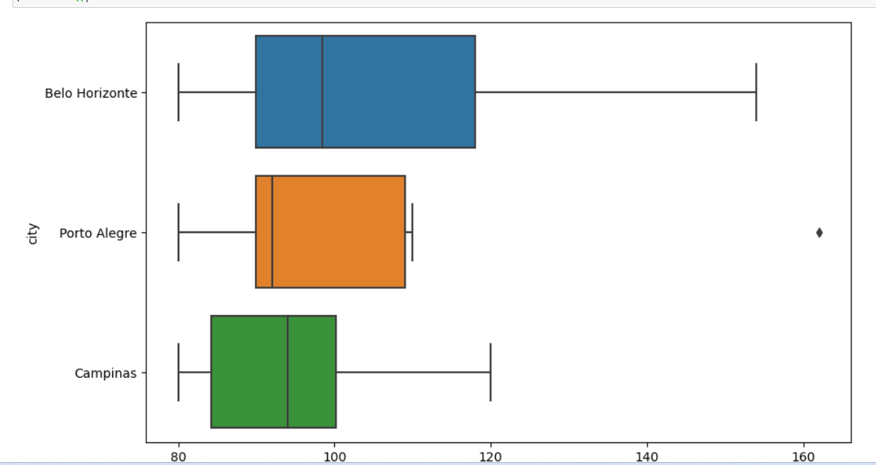
LEVEL-3 MULTIVARIATE ANALYSIS
Further Analysis
Which area is the best for Mid size family among the three cities?
which area has the most Spreaded?
Which city has the houses at affordable price?
Deeper Analysis
Which city has the offer for Mid size family at most affordable price,so that they can relocate themselves which is fulfilling all their basic needs

Slide 22
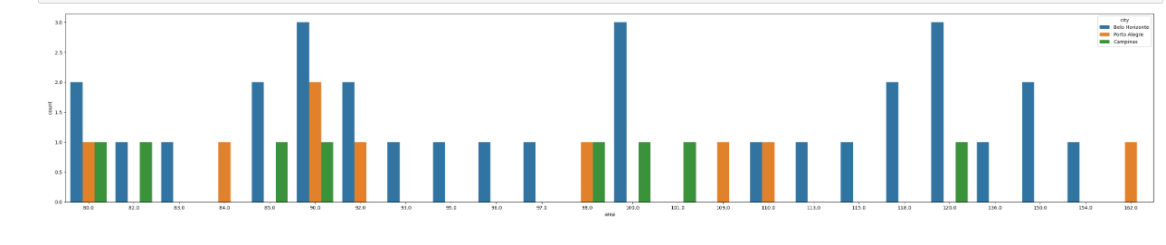
Interpretation: Belo Horizonte is showing here the houses of area between 80 to 200,with at least 2 rooms and almost 4 rooms at lowest price. So we can conclude that Belo Horizonte is the best suited city for Mid Size Family to relocate.

Slide 23
Interpretation on Mid-sized families :
Belo Horizonte city is most suitable for Mid sized families with 2-4 rooms, 2-3 bathroom , one parking space, fully furnished with less than average rent amount and wide area space availability.

Slide 24
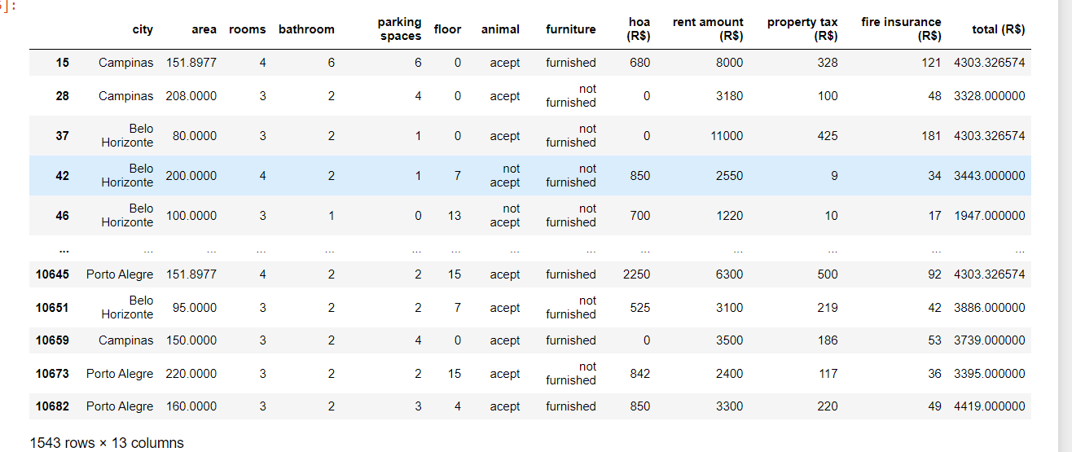
TASK-3 ANALYSIS OF ROOMS TO RELOCATE FOR LARGE SIZE FAMILY
LEVEL-1 UNIVARIATE ANALYSIS
filtering the data for Large size family to relocate based on the findings of the previously mentioned univariate analysis.
Considering the number of rooms for Large size family is more than or equal to 5.

Slide 25
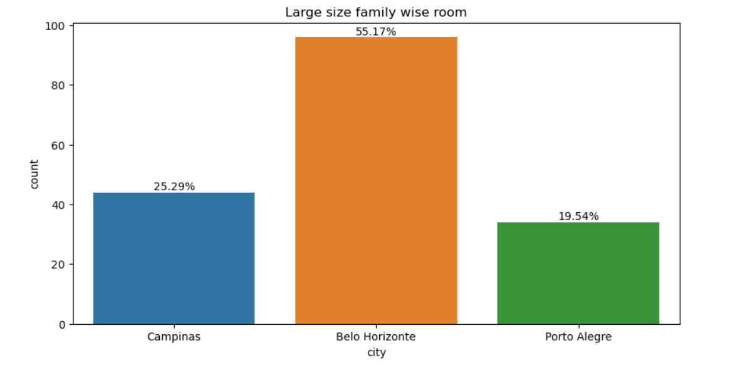
Interpretation: As the above Count plot indicates that Belo Horizonte has the highest availability of rooms that is approx. 51% for mid size family, those who wants at least 2 rooms and at most 4 rooms.

Slide 26
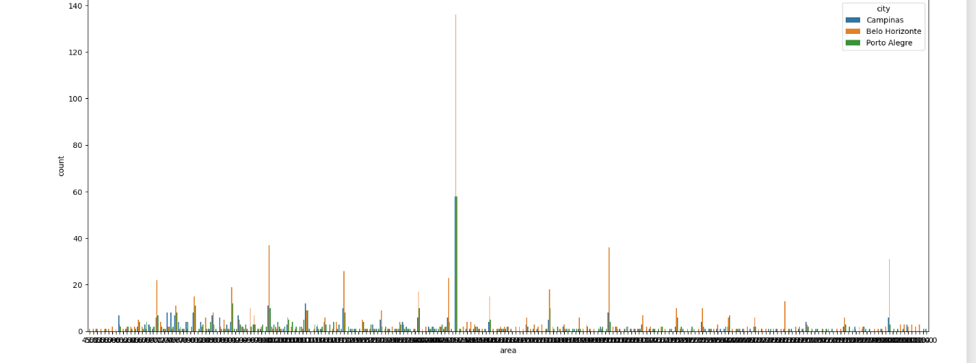
LEVEL-2 BIVARIATE ANALYSIS
RELATIONSHIP OF CITY WITH AREA
Interpretation:As the above Countplot indicates that Belo Horizonte has the widest range of rooms available in the area than other two cities.Now for further analysis we will proceed to Multivaraiate analysis.

Slide 27
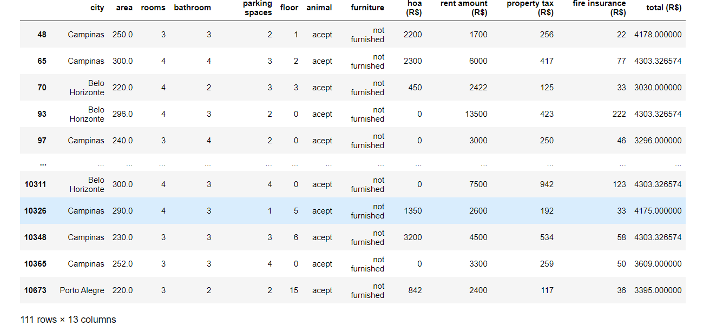
LEVEL-3 MULTIVARIATE ANALYSIS
Further Analysis
Which area is the most suitable for large size family among the three cities?
which area has the most Spreaded?
Which city has the houses at
affordable price according to the needs for large size family?
Deeper Analysis
Which city has the best offer for Large size family at most affordable price,so that they can relocate themselves which is fulfilling all their basic needs.

Slide 28
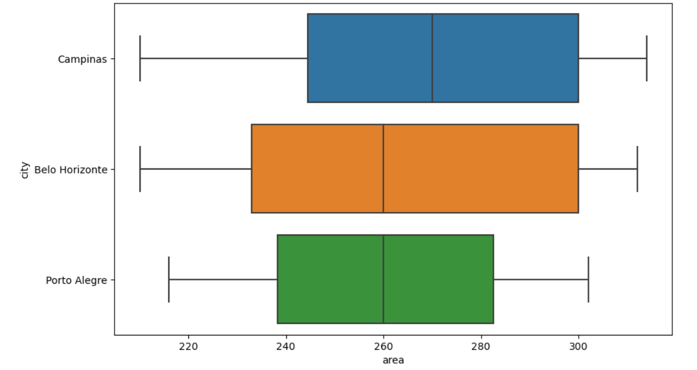
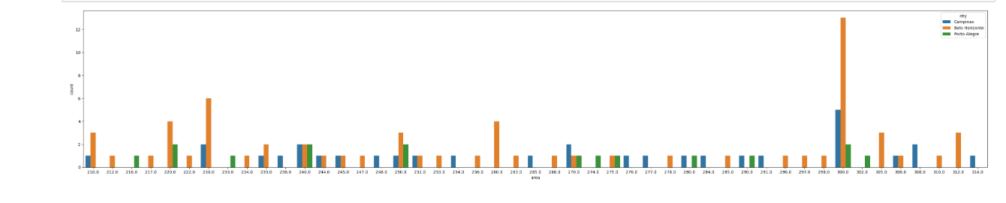

Slide 29
Interpretation on large families : Belo Horizonte city is most suitable for large families with 4-6 rooms, 3-5 bathroom , 2-4 parking space, fully furnished with less than average rent amount and wide area space availabilty.The total amount will increase with the increase in the rooms and area.

Slide 30


